Slide 1
Talk to Me
by TADAA
Oct 12, 2020
Alex Kostin - PO
Tyler Hoang - SM
Alex Lau
Duncan Bark
Andrew Zhu

Slide 2
Talk to Me
Problem
Due to the pandemic, people may not be socializing as much as they used to, which may lead to feelings of sadness and loneliness.
Solution
Our solution to this is a website dedicated to emotionally supporting each other through heartfelt conversation. Due to understandable privacy and accessibility concerns, we’ve decided to make this service anonymous.

Slide 3
Project Scope
High level goal
Create a website where a user can press a button, and be connected to someone from whom they can receive (and give) emotional support in the form of anonymous text conversation.

Slide 4
Sprint 1
User Stories
As a user, I want to to be able to be given a private chat room, so I could talk without anyone else seeing.
Effort: 8 SP Priority: Must
As a user, I want to be able to send and receive messages, so I can talk away my loneliness.
Effort: 5 SP Priority: Must
Spikes
Learning Angular for frontend.
Learning Flask and MongoDB for backend.
Infrastructure
Setting up AWS and Domain for web hosting.
Set up GitHub for codebase management.

Slide 5
Sprint 2
User Stories
As a user, I want to be able to match with someone who can hear me vent, so I can vent.
Effort: 8 SP Priority: Must
As a user, I want to be able to like messages, so I can show people I like what they’re saying.
Effort: 3 SP Priority: Could
As a site admin, I want to show a popup to users detailing the purpose of the site, so I minimize people trolling.
Effort: 2 SP Priority: Should
Spikes
None predicted.
Infrastructure
None predicted.

Slide 6
Sprint 3
User Stories
As a user, I want to be able to report people that send offensive messages, so I don’t chat with them again.
Effort: 13 SP Priority: Should
As a site admin, I want to be able to view reported messages, so I can view reports.
Effort: 1 SP Priority: Should
As a site admin, I want to be able to block IPs/users from chatting, so I can prevent trolls.
Effort: 3 SP Priority: Should
Spikes
None predicted.
Infrastructure
None predicted.

Slide 7
Sprint 4
User Stories
As a site admin, I want to view reports in a nicely formatted way, so that it’s convenient to manage the site.
Effort: 8 SP Priority: Could
As a user, I want to be able to chat in same language as other user, so we can understand each other.
Effort: 5 SP Priority: Could
Spikes
None predicted.
Infrastructure
None predicted.

Slide 8
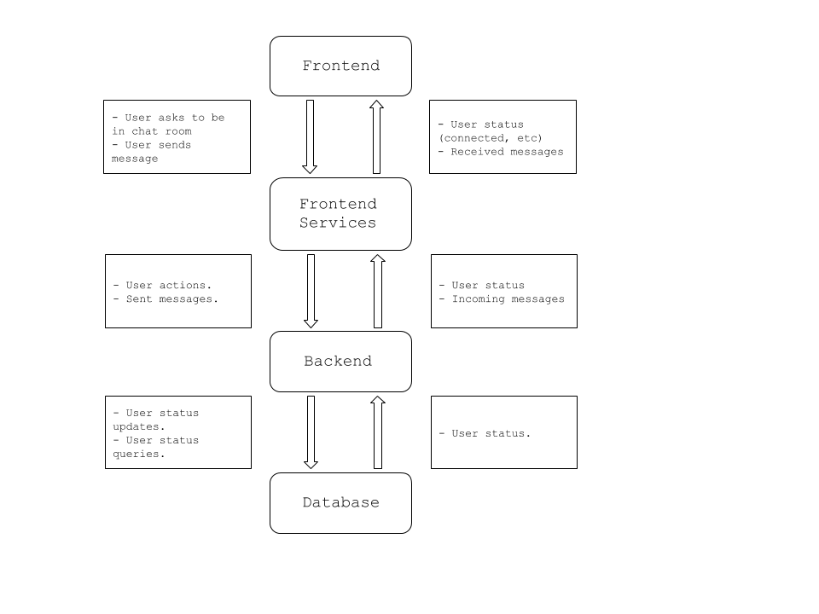
Architecture
Frontend
Displays messages and connection information.
Communicates with frontend services to receive status
updates and messages, sends user actions and messages.
Frontend Services
Relays user actions and sent messages to backend, user
status and incoming messages to frontend.
Backend
Provides user status updates (waiting for match, connected,
etc…) and sends/receives messages to/frontend. Keeps
track of user status in database.
Database
Contains user statuses, receives updates and queries from
backend, sends query answers to database.

Slide 9

Technologies
Frontend
HTML, CSS, JS, Angular.
Backend
Python, Flask, MongoDB.
Infrastructure
Git, Docker, Python.

Slide 10
Challenges/Risks
Challenges
Learning new frameworks/technologies.
Updating chat in real time.
Managing reports.
Risks
Potentially larger than expected project scope.
Security - users trusting us with keeping their anonymity.

Slide 11
Minimum Viable Product
Barebones version of product that does what was promised to the user.
Website that lets you anonymously send messages back and forth with a random user.
Accomplished via two user stories:
As a user, I want to to be able to be given a private chat room, so I could talk without anyone else seeing.
As a user, I want to be able to send and receive messages, so I can talk away my loneliness.

